Slide 1
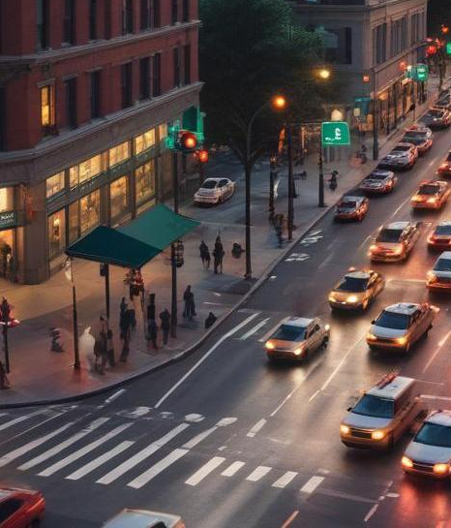
TrafficSync
Multi-Agent System for Smart Traffic Management

Slide 2
Introduction
This presentation outlines the TrafficSync system, focusing on its innovative approach to urban traffic management. It highlights the challenges faced by cities in managing congestion and the vital role that technology and AI play in optimizing traffic flow and emergency response.

Slide 3
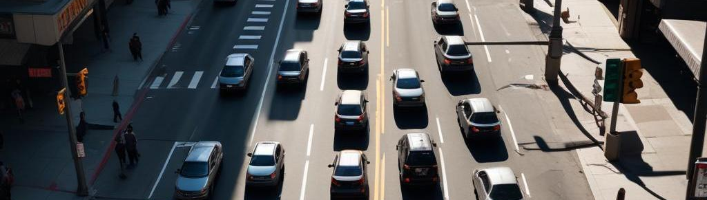
01
Problem & Opportunity

Slide 4
Urban congestion costs
Urban congestion leads to significant economic losses, costing cities billions in wasted time, fuel, and decreased productivity. Traffic jams impact daily commutes and increase pollution, creating a pressing need for smart solutions that can optimize traffic flow.

Slide 5

Emergency response impact
Traffic congestion critically affects emergency vehicle response times, delaying critical services when seconds matter. Improved traffic management is essential to ensure that emergency services can reach their destinations without undue delay, potentially saving lives.

Slide 6
Need for AI-driven solutions
The increasing complexity of urban traffic requires smarter, more adaptive solutions. Traditional fixed-time traffic signals are insufficient in dynamically changing environments. AI-driven approaches can analyze real-time data and adjust traffic signals and vehicle routes instantaneously, vastly improving efficiency and reducing congestion. This represents a major opportunity to enhance urban living through technology.

Slide 7
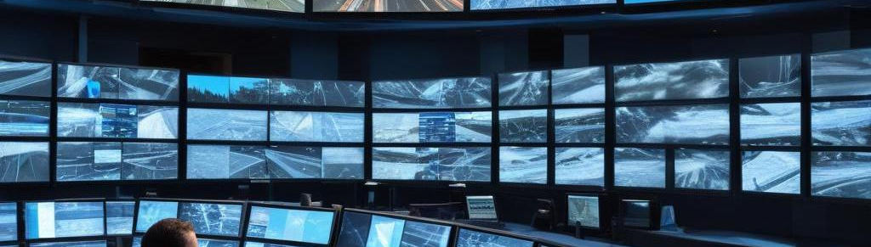
02
Solution Overview

Slide 8
Multi-agent system structure
TrafficSync utilizes a multi-agent system where individual agents represent traffic lights, vehicles, and emergency services. Each agent operates based on real-time data to make decisions about traffic flow and emergency response. This structure enables localized decision-making while still contributing to the overall efficiency of the traffic network.

Slide 9
Key innovations in coordination
Key innovations in TrafficSync include event-driven communication among agents, allowing for adaptive coordination without the need for central control. This emergent behavior lets agents respond to real-time changes in traffic conditions, optimizing flow across the network while ensuring that emergency vehicles can navigate quickly and effectively.

Slide 10

Adaptive traffic management
TrafficSync employs adaptive signal timing algorithms that adjust in response to live traffic patterns and emergencies. By using historical data and real-time inputs, the system can create priority corridors for emergency services and dynamically manage traffic signals to enhance overall traffic flow and reduce congestion.

Slide 11

Conclusions
In conclusion, TrafficSync is a revolutionary solution that leverages AI and multi-agent systems to address urban traffic challenges. By optimizing traffic flow and enhancing emergency response times, TrafficSync not only saves lives but also improves the overall quality of urban life. The ability to adapt and learn from traffic patterns positions TrafficSync as a critical tool for modern cities.

Slide 12
Thank you!

